Slide 1
Case study – Eventbright Hotel Data
Table of content Slide
Introduction 2
Hotel Performance 3
Response Behavior and insights 4
Planner Behavior and insights 5
Group Room Rate Trends 6
Missed Opportunities 7
Conversion Rate 8
Winning Strategies 9
Presented by: Dhaval Prajapati
Tool used: MS Power BI and MS Excel
Other supporting files for reference:
‘Hotel Data Case Study_Appendix_Slides.pdf’
‘Hotel Data Case Study.pbix’

Slide 2
Case Study Introduction
Objective:
Leverage available data to derive insights and for strategic actions.
Requirements:
Speed up responses to win more RFPs.
Identify reasons for missed opportunities.
Optimize pricing, guest room and meeting room inventory.
Align with planner booking preferences.
Strengthen competitive positioning.
Business Goal:
To enhance the conversion rate of RFPs by optimizing response efficiency, pricing strategies, and planner engagement, ultimately maximizing revenue and market share.
Event Planners
Venues where events will be held.
Connects event planners with venues
Stake holders/Point of View (POV)

Slide 3
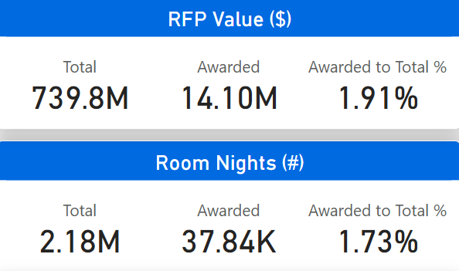
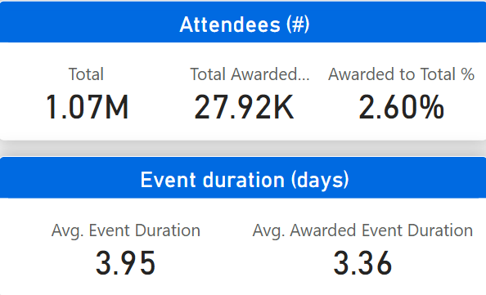
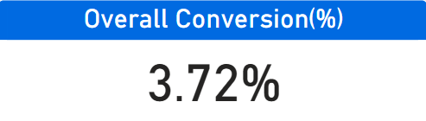
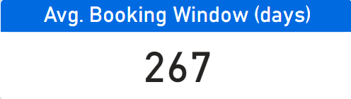
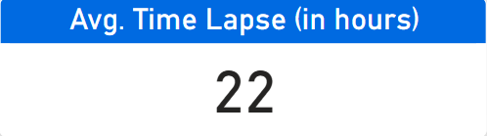
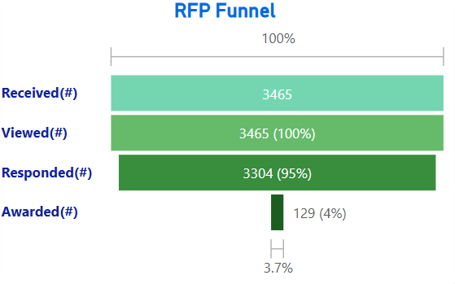
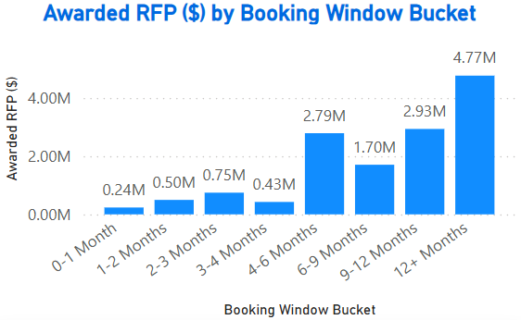
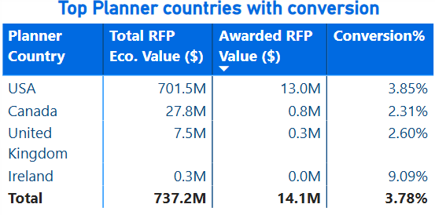
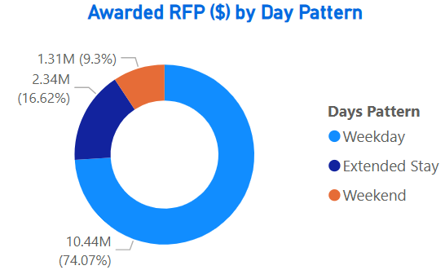
Overall Hotel Performance
Performance highlights
Total RFP Value: ~$740 M received
RFP value per Attendee:
Total: ~$339
Awarded: ~$373
Room nights (RN) per Attendee:
Total: ~2 RN
Awarded: ~1 RN
Points of consideration
RFP Funnel: While 100% of RFPs are viewed, 5% remain un-responded. The gap between RFPs awarded and responded is significant.
Country Insights: USA leads in RFP value, while Ireland has the highest conversion rate.
Booking Trends: Majority of business is secured 12+ months in advance.
Day-wise Pattern: Most RFPs are for weekdays, presenting an opportunity to optimize weekend bookings.
Notes: ($) refers to values in US dollars and (#) refers to count/sum.

Slide 4
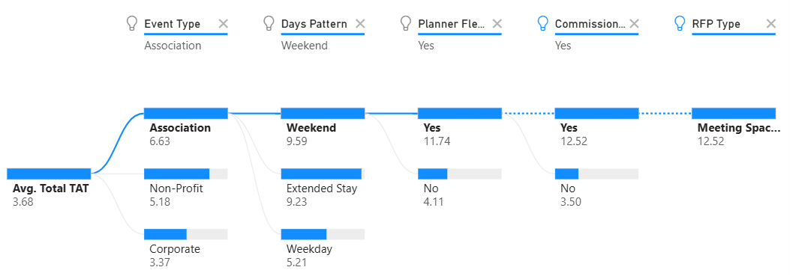
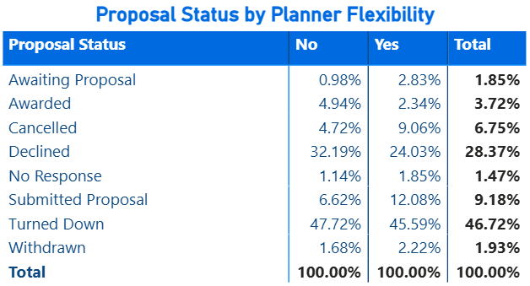
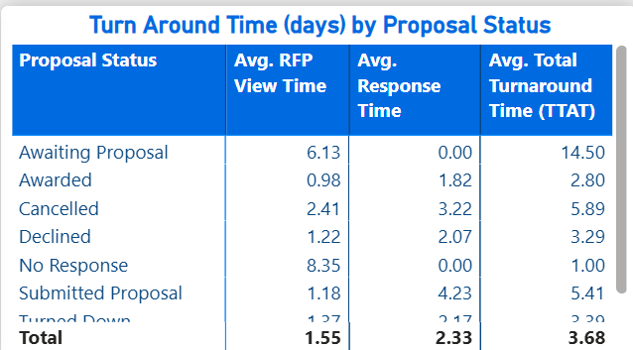
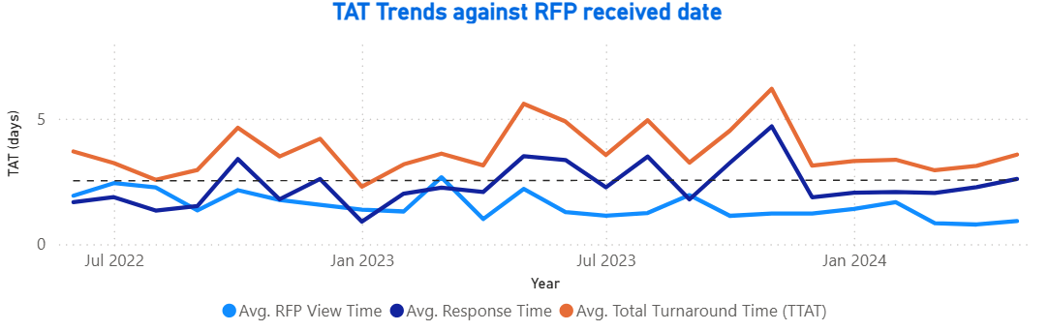
Response Behavior
Points of consideration
1.85% of total RFPs are still awaiting proposals.
~45% of turned-down RFPs were flexible, yet the business was lost.
Cancelled and Declined RFPs account for ~35% of total RFPs. These can potentially be won back by offering more flexibility in rates and conditions.
TATs for ‘Awarded’ RFPs are comparatively lower than non-awarded RFPs. RFPs with a faster response time tend to have a higher chance of being awarded.
Highlights
Average Total TAT (number of days between RFP received date and response date) is significantly influenced by association event types, along with other variables.
Average Response Time has been increasing over time, which could be a concern and a potential reason for missed business.

Slide 5
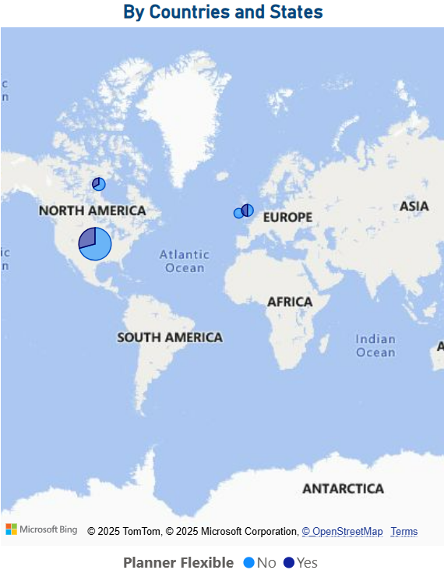
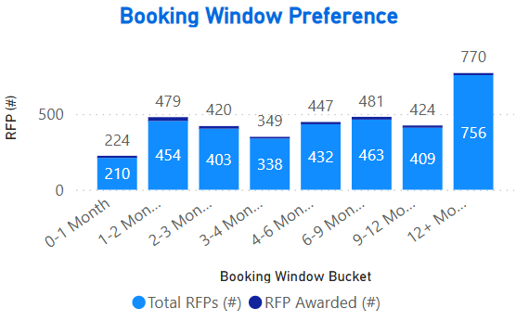
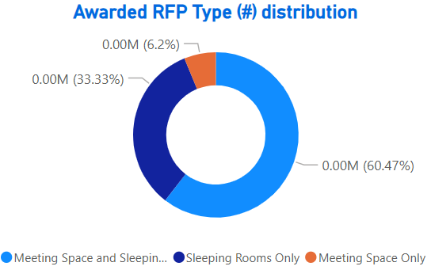
Planner Behavior & Insights
Highlights
Points of consideration
The USA is the largest contributor in terms of both total RFP value and awarded RFP value.
A significant portion of RFPs fall into the 12+ months booking window, indicating that planners prefer securing venues well in advance however only few RFPs get materialized as compared to 1-2 months booking window.
‘Meeting Space Only’ contributes a small proportion of business.

Slide 6
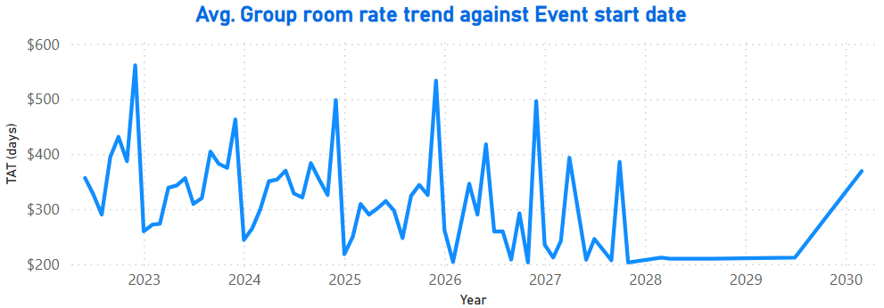
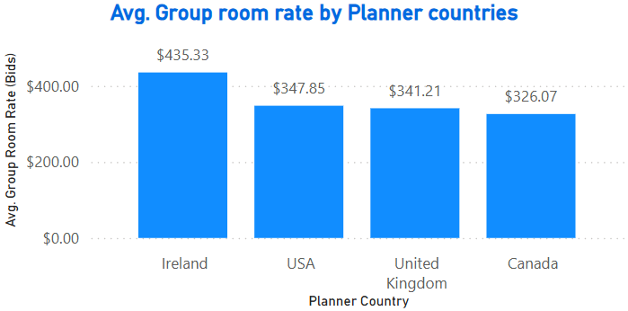
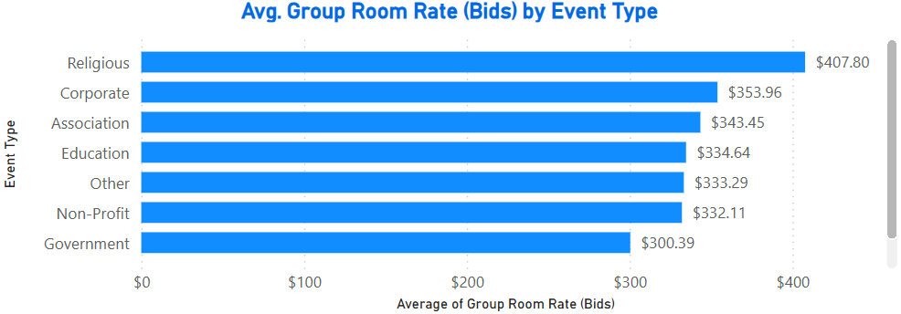
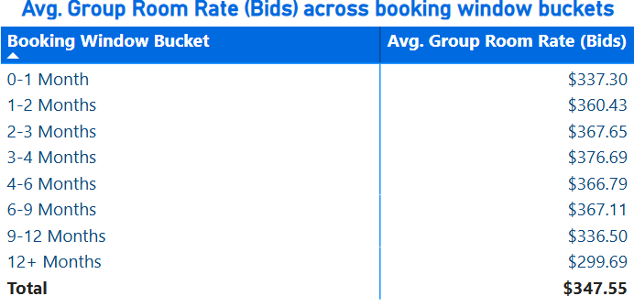
Group Room Rate Trends
Highlights
Points of consideration
Group room rate bids have shown a downward trend over time when considering future business by event start date.
Peak rates during high-demand periods indicate strong seasonality, while there is a flat pricing between 2028 and 2029, 2030.
The average group rate is highest for religious event type.
The average group room rate bid is highest in Ireland, followed by the USA.
The highest average group room rate bid is observed in the '3-4 Months' booking window bucket.

Slide 7
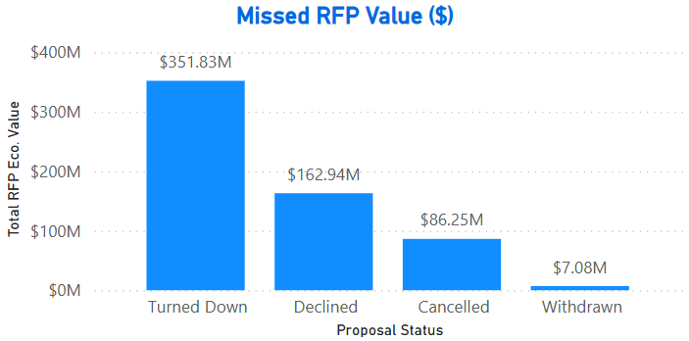
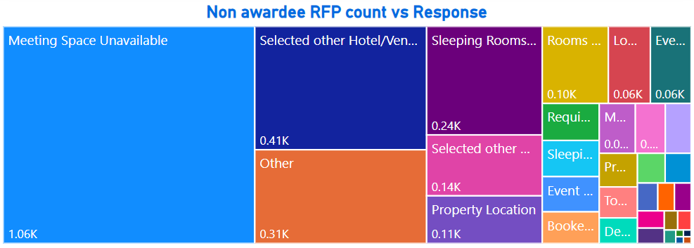
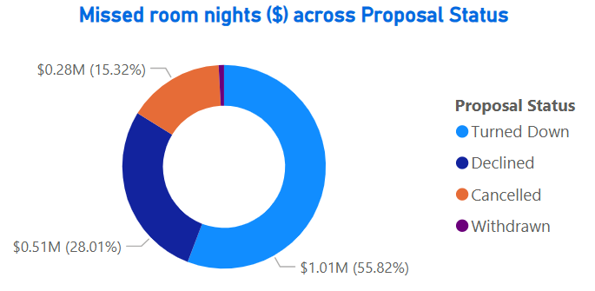
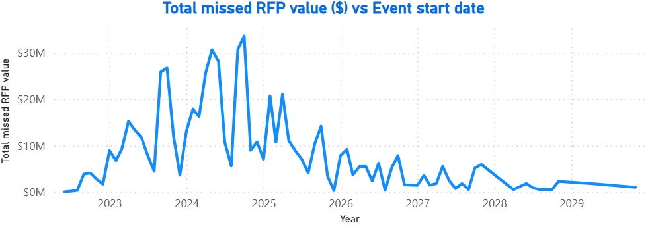
Missed Opportunities
Highlights
Points of consideration
Approximately $352 million in RFP value and $1 million worth of room nights were turned down.
"Meeting space unavailable" had the highest contribution among non-awarded RFPs, followed by "Selected other hotel/venue," together accounting for approximately 50% of the total, highlighting concerns over the competitive set strategy.
The total missed RFP value was significantly high in the past, peaking between 2023 and 2025. Again, there is a spike in trend between Dec.’25 to Feb.’26
Note: For 'Missed' business we have only considered 'Cancelled', 'Declined', 'Turned down', 'Withdrawn' cases of 'Proposal Status' column.

Slide 8
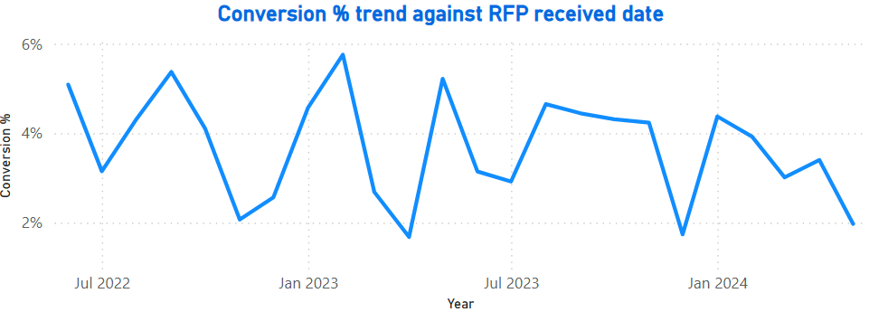
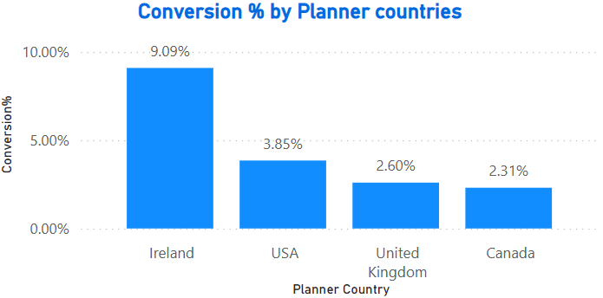
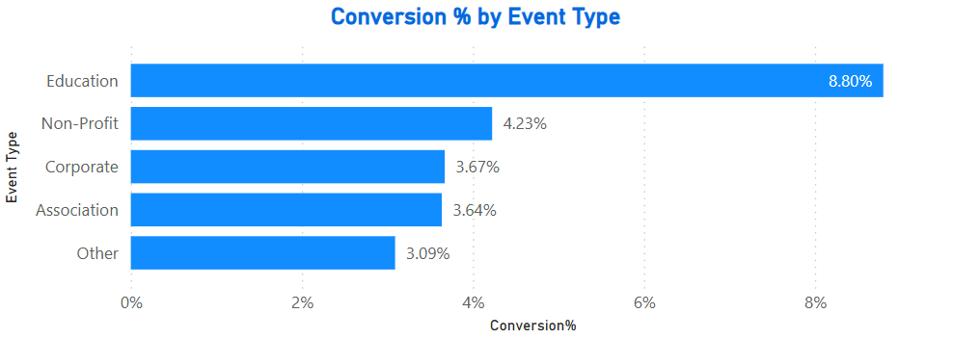
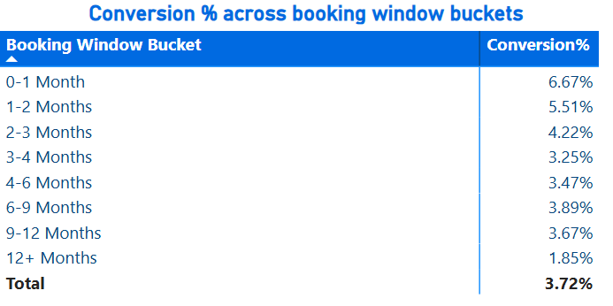
Conversion Rate
Highlights
Points of consideration
Conversion % showed a declining trend between January 2024 and May 2024 based on the RFP received date.
'Education' had the highest conversion %, while 'Other' event types had the lowest.
Ireland recorded the highest conversion rate, whereas Canada had the lowest.
Conversion % was highest for shorter booking windows, particularly in the ‘0-1 Month’ and ‘1-2 Months’ buckets.

Slide 9
Winning Strategies
Enhance Response Efficiency
Reduce response time as faster responses correlate with higher conversion. Address declining conversion trend (Jan-May 2024) with proactive response measures. Prioritize ‘Education’ events, which have the highest conversion rate and improve on other event types.
Optimize Pricing & Flexibility
Win back 35% of Cancelled & Declined RFPs by offering flexible rates & terms. Optimize flat pricing between 2028-2029 to capture seasonal demand better.
Improve Competitive Positioning
50% of non-awarded RFPs has ‘Meeting space unavailable’ & ‘Selected other hotel’ as reasons. Improve availability & competitive pricing.
Apply successful strategies to improve conversion of weaker regions
Address Missed Business Opportunities
$352M RFP value and $1M in room nights were turned down – to develop retention strategies. Missed RFP value peaked (2023-2025) & spiked (Dec 2025-Feb 2026) – to identify and mitigate causes.

Slide 10
Thank You!

